Slide 1
INSPIRE The Insieme Parallel Intermediate Representation
Herbert Jordan, Peter Thoman, Simone Pellegrini, Klaus Kofler, and Thomas Fahringer
University of Innsbruck
PACT’13 - 9 September

Slide 2
Programming Models
User:
HW:
C / C++
void main(…) {
int sum = 0;
for(i = 1..10)
sum += i;
print(sum);
}
C
Memory

Slide 3
Programming Models
User:
Compiler:
HW:
C / C++
PL → Assembly
instruction selection
register allocation
optimization
void main(…) {
int sum = 0;
for(i = 1..10)
sum += i;
print(sum);
}
C
Memory
IR
.START ST ST: MOV R1,#2 MOV R2,#1 M1: CMP R2,#20 BGT M2 MUL R1,R2 INI R2 JMP M1

Slide 4
Programming Models
User:
Compiler:
HW:
C / C++
PL → Assembly
instruction selection
register allocation
optimization
loops & latency
void main(…) {
int sum = 0;
for(i = 1..10)
sum += i;
print(sum);
}
C
$
Memory
IR
.START ST ST: MOV R1,#2 MOV R2,#1 M1: CMP R2,#20 BGT M2 MUL R1,R2 INI R2 JMP M1

Slide 5
Programming Models
User:
Compiler:
HW:
C / C++
PL → Assembly
instruction selection
register allocation
optimization
loops & latency
void main(…) {
int sum = 0;
for(i = 1..10)
sum += i;
print(sum);
}
C
$
Memory
IR
.START ST ST: MOV R1,#2 MOV R2,#1 M1: CMP R2,#20 BGT M2 MUL R1,R2 INI R2 JMP M1
10 year old
architecture

Slide 6
Parallel Architectures
Multicore:
Accelerators:
Clusters:
C
C
G
C
C
C
C
C
C
$
$
$
M
$
$
M
Memory
M
M
M
OpenMP/Cilk
OpenCL/CUDA
MPI/PGAS

Slide 7
Compiler Support
lib
C / C++
IR
pfor:
mov eax,-2
cmp eax, 2 xor eax, eax
...
void main(…) {
int sum = 0; #omp pfor
for(i = 1..10)
sum += i;
}
.START ST ST: MOV R1,#2 MOV R2,#1
_GOMP_PFOR
M1: CMP R2,#20 BGT M2 MUL R1,R2 INI
bin
Start:
mov eax,2
mov ebx,1
call “pfor”
Label 1:
lea esi, Str
push esi
Frontend
Backend
sequential

Slide 8
Situation
Compilers
unaware of thread-level parallelism
magic happens in libraries
Libraries
limited perspective / scope
no static analysis, no transformations
User?
has to coordinate complex system
no performance portability

Slide 9
Parallel Architectures
Multicore:
Accelerators:
Clusters:
C
C
G
C
C
C
C
C
C
$
$
$
M
$
$
M
Memory
M
M
M
OpenMP/Cilk
OpenCL/CUDA
MPI/PGAS

Slide 10
Real World Architectures
C
C
G
C
C
G
C
C
G
C
C
G
C
C
C
C
C
C
G
C
C
C
C
$
C
C
$
$
M
M
$
M
M
$
M
M
M
M
M
M
Embedded - Desktop
> Desktop

Slide 11
Real World Architectures
C
C
C
C
OpenMP/Cilk
$
C
C
G
Memory
C
C
G
C
C
G
C
C
C
C
G
$$≠$$
G
C
C
C
C
C
OpenCL/CUDA
C
C
$
$
$
$
M
M
$
M
M
M
M
M
M
M
M
C
C
MPI/PGAS
C
$
$
$
M
M
M

Slide 12
Approaches
Option A: pick one API and settle
OpenMP / OpenCL / MPI
no full resource utilization
still not trivial
Option B: hybrid approach
combine APIs
multiple levels of parallelism
user has to coordinate APIs
OpenCL
Cuda
OpenMP
C / C++
MPI
pthreads
SIMD Ref.
Architecture

Slide 13
Situation (con’t)
Compilers
unaware of thread-level parallelism
magic happens in libraries
Libraries
limited perspective / scope
no static analysis, no transformations
User
has to manage and coordinate parallelism
no performance portability

Slide 14
Situation
Compilers
unaware of thread-level parallelism
magic happens in libraries
Libraries
limited perspective / scope
no static analysis, no transformations
User
has to manage and coordinate parallelism
no performance portability

Slide 15
Compiler Support?
HW:
Compiler:
User:
PL → Assembly
instruction selection
register allocation
optimization
loops & latency
vectorization
C / C++
C
C
G
void main(…) {
int sum = 0;
for(i = 1..10)
sum += i;
print(sum);
}
C
C
G
C
C
G
C
C
C
C
G
C
C
C
C
C
C
$
$
$
M
M
$
M
M
M
M
M
M
IR
.START ST ST: MOV R1,#2 MOV R2,#1 M1: CMP R2,#20 BGT M2 MUL R1,R2 INI R2 JMP M1

Slide 16
Our approach:
HW:
Compiler:
User:
PL → Assembly
instruction selection
register allocation
optimization
loops & latency
vectorization
C / C++
C
C
G
void main(…) {
int sum = 0;
for(i = 1..10)
sum += i;
print(sum);
}
C
C
G
C
C
G
C
C
C
C
G
C
C
C
C
C
C
$
$
$
M
M
$
M
M
M
M
M
M
IR
.START ST ST: MOV R1,#2 MOV R2,#1 M1: CMP R2,#20 BGT M2 MUL R1,R2 INI R2 JMP M1

Slide 17
Our approach: Insieme
HW:
Compiler:
Insieme:
User:
PL → Assembly
instruction selection
register allocation
optimization
loops & latency
vectorization
PL → PL + extras
coordinate parallelism
high-level optimization
auto tuning
instrumentation
C
C
G
C / C++
C
C
G
void main(…) {
int sum = 0; #omp pfor
for(i = 1..10)
sum += i;
}
C
C
G
C
C
C
C
G
C
C
C
C
C
C
$
$
$
M
M
$
M
M
M
M
M
M
IR
INSPIRE
.START ST ST: MOV R1,#2 MOV R2,#1 M1: CMP R2,#20 BGT M2 MUL R1,R2 INI R2 JMP M1
unit main(...) {
ref<int> v1 =0;
pfor(..., (){
...
});
}

Slide 18
The Insieme Project
Goal:
to establish a research platform for hybrid, thread level parallelism
Frontend
Static Optimizer
Dyn. Optimizer
IR Toolbox
IRSM
Scheduler
C/C++
OpenMP
Cilk
OpenCL
MPI
and extensions
Frontend
Backend
Monitoring
INSPIRE
Runtime System
Exec. Engine
Compiler
Runtime
Events

Slide 19
Parallel Programming
OpenMP
Pragmas (+ API)
Cilk
Keywords
MPI
library
OpenCL
library + JIT
Objective:
combine those using a unified formalism and to provide an infrastructure for analysis and manipulations

Slide 20
INSPIRE Requirements
OpenMP / Cilk / OpenCL / MPI / others
complete
unified
explicit
analyzable
transformable
compact
high level
whole program
open system
extensible
INSPIRE
OpenCL / MPI / Insieme Runtime / others

Slide 21
INSPIRE
Functional Basis
first-class functions and closures
generic (function) types
program = 1 expression
Imperative Constructs
loops, conditions, mutable state
Explicit Parallel Constructs
to model parallel control flow

Slide 22
Parallel Model
Parallel Control Flow
defined by jobs: $job\left[e_{l},e_{u}\right]\left(…\right) f$
processed cooperatively by thread groups

Slide 23
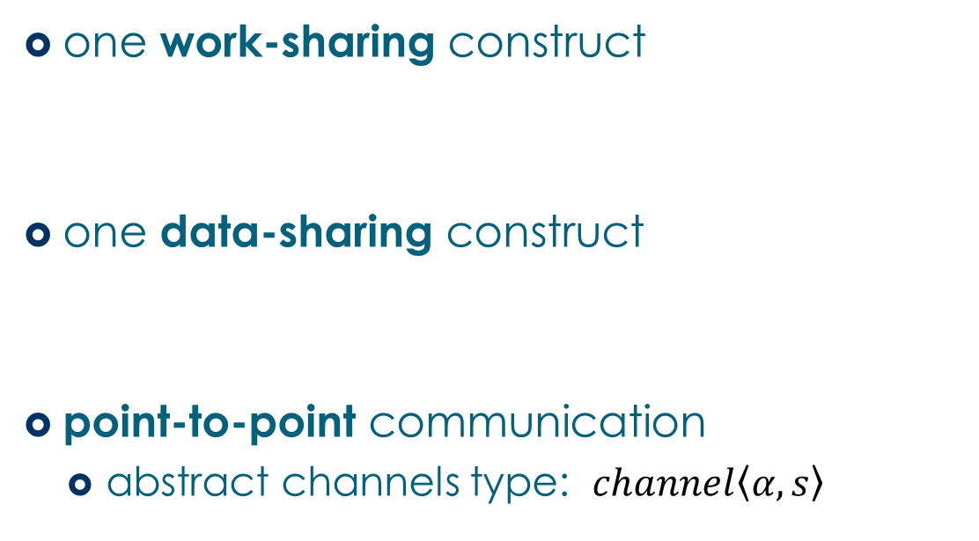
Parallel Model (2)
one work-sharing construct
one data-sharing construct
point-to-point communication
abstract channels type: $channel\left\langle α,s\right\rangle$

Slide 24
Simple Example
#pragma omp parallel for
for(int i=0; i<10; i++) {
a[i] = b[i];
}
OpenMP
INSPIRE
merge(parallel(job([1-inf])
() =>
(ref<int<4>[10]> v30, ref<int<4>[10]> v31) -> unit {
pfor(0, 10, 1, (v23, v24, v25) =>
(ref<int<4>[10]> v18, ref<int<4>[10]> v19, int<4> v20, int<4> v21, int<4> v22) -> unit {
for(int<4> v12 = v20 .. v21 : v22) {
v18[v12] := v19[v12];
};
} (v30, v31, v23, v24, v25)
);
barrier();
} (v1, v10)
));

Slide 25
Simple Example
#pragma omp parallel for
for(int i=0; i<10; i++) {
a[i] = b[i];
}
OpenMP
INSPIRE
merge(parallel(job([1-inf])
() =>
(ref<int<4>[10]> v30, ref<int<4>[10]> v31) -> unit {
pfor(0, 10, 1, (v23, v24, v25) =>
(ref<int<4>[10]> v18, ref<int<4>[10]> v19, int<4> v20, int<4> v21, int<4> v22) -> unit {
for(int<4> v12 = v20 .. v21 : v22) {
v18[v12] := v19[v12];
};
} (v30, v31, v23, v24, v25)
);
redistribute(unit, (unit[] data) -> unit { return unit; });
} (v1, v10)
));

Slide 26
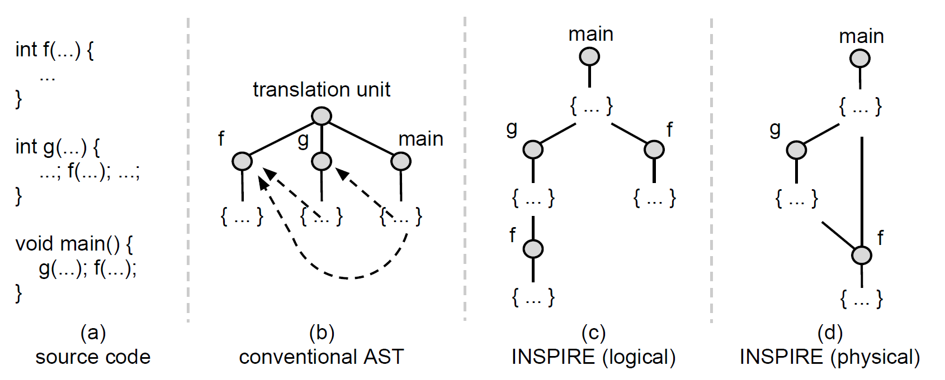
Overall Structure
Structural – opposed to nominal systems
full program is a single expression

Slide 27
Overall Structure
Consequences:
every entity is self-contained
no global lookup-tables or translation units
local modifications are isolated
Also:
IR models execution – not code structure
path in tree = call context (!)

Slide 28
Evaluation
What inherent impact does the INSPIRE detour impose?
GCC 4.6.3 (-O3)
Binary A
(GCC)
C
Input
Code
FE
INSPIRE
BE
C
Binary B
(Insieme)
Insieme Compiler
Target
Code
(IRT)
No Optimization!

Slide 29
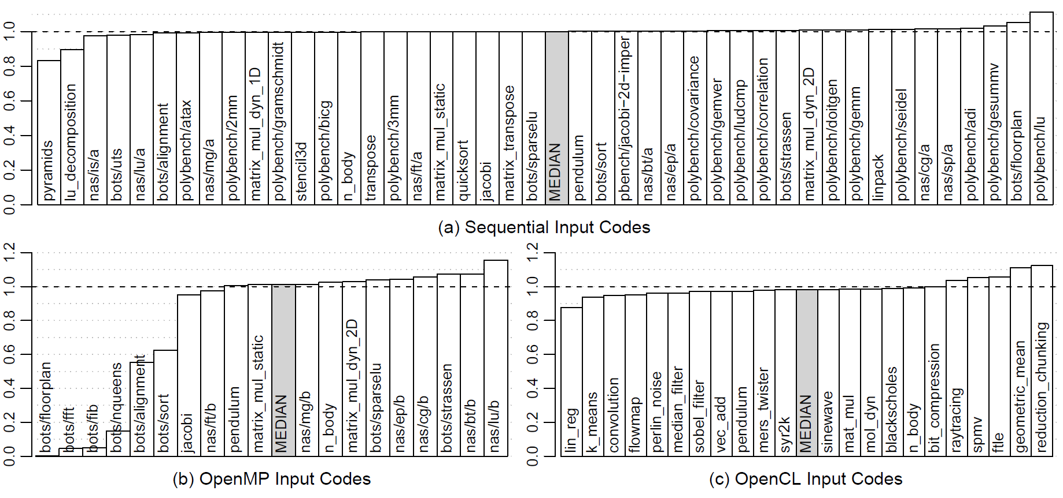
Performance Impact
Relative execution time ($t_{insieme}/t_{original}$)

Slide 30
Derived Work (subset)
Adaptive Task Granularity Control
P. Thoman, H. Jordan, T. Fahringer, Adaptive Granularity Control in Task Parallel Programs using Multiversioning, EuroPar 2013
Declarative Transformation System
H. Jordan, P. Thoman, T. Fahringer, A high-level IR Transformation System, PROPER 2013
Multiobjective Auto-Tuning
H. Jordan, P. Thoman, J. J. Durillo et al., A Multi-Objective Auto-Tuning Framework for Parallel Codes, SC 2012
Compiler aided Loop Scheduling
P. Thoman, H. Jordan, S. Pellegrini et al., Automatic OpenMP Loop Scheduling: A Combined Compiler and Runtime Approach, IWOMP 2012
OpenCL Kernel Partitioning
K. Kofler, I. Grasso, B. Cosenza, T. Fahringer, An Automatic Input-Sensitive Approach for Heterogeneous Task Partitioning, ICS 2013
Improved usage of MPI Primitives
S. Pellegrini, T. Hoefler, T. Fahringer, On the Effects of CPU Caches on MPI Point-to-Point Communications, Cluster 2012

Slide 31
Derived Work (subset)
Adaptive Task Granularity Control
P. Thoman, H. Jordan, T. Fahringer, Adaptive Granularity Control in Task Parallel Programs using Multiversioning, EuroPar 2013
Multiobjective Auto-Tuning
H. Jordan, P. Thoman, J. J. Durillo et al., A Multi-Objective Auto-Tuning Framework for Parallel Codes, SC 2012
Compiler aided Loop Scheduling
P. Thoman, H. Jordan, S. Pellegrini et al., Automatic OpenMP Loop Scheduling: A Combined Compiler and Runtime Approach, IWOMP 2012
OpenCL Kernel Partitioning
K. Kofler, I. Grasso, B. Cosenza, T. Fahringer, An Automatic Input-Sensitive Approach for Heterogeneous Task Partitioning, ICS 2013
Improved usage of MPI Primitives
S. Pellegrini, T. Hoefler, T. Fahringer, On the Effects of CPU Caches on MPI Point-to-Point Communications, Cluster 2012

Slide 32
Conclusion
INSPIRE is designed to
represent and unify parallel applications
to analyze and manipulate parallel codes
provide the foundation for researching parallel language extensions
based on comprehensive parallel model
sufficient to cover leading standards for parallel programming
Practicality has been demonstrated by a variety of derived work

Slide 33
Thank You!
Visit: http://insieme-compiler.org
Contact: herbert@dps.uibk.ac.at

Slide 34
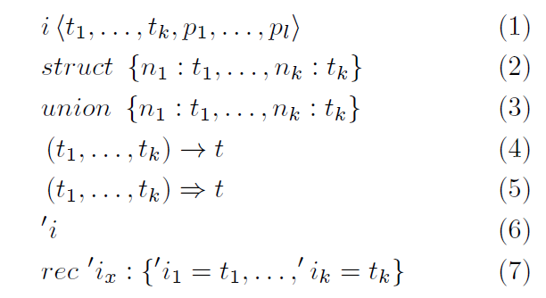
Types
7 type constructors:

Slide 35
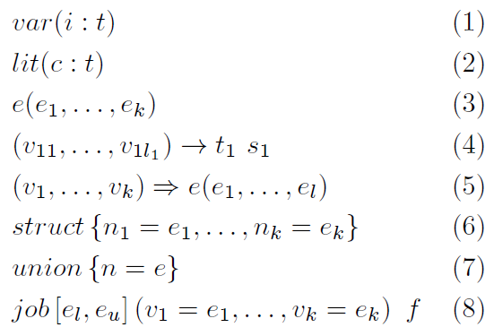
Expressions
8 kind of expressions:

Slide 36
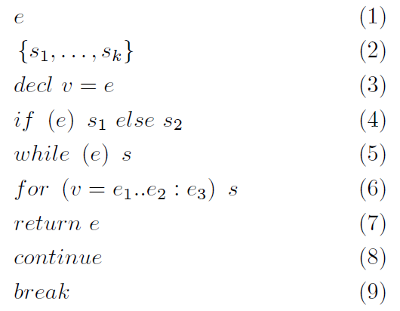
Statements
9 types of statements:

